Slide 1
Introducing Open Box Software
There’s always a better way

Slide 2
Our Company
MRI Support & Services
Case Studies
How Can We Help?

Slide 3
Our Company

Slide 4





Our Unique Offering
Bringing industry knowledge and innovative technologies together in practical solutions
Real Estate experience
Proven track record of delivery
Focus on long-term relationships
Flexible approach to delivery
Offshore prices with onshore quality
18 years working with leaders in Real Estate
Leading edge of proptech innovation
100+ RE focused staff members
Microsoft Gold Partner
Over 350 project deliveries
20 countries
Client needs come first
Always finding a better way
Value long term partnerships over short term gains
55 current RE clients
Our first client is still with us, 45 applications later
Fixed cost, FTE or T&M
No project too big or too small
Broad range of services, skills and technologies
Labour cost arbitrage with no language barrier
Onsite presence where needed
Offshore work delivered to the highest standard
Notes:
South African company with global reach
3 golden threads
We know real estate
Therefore we understand your needs
We have a track record of excellence with your peers
You will see many quotes from our clients
We have a history of remote delivery
Particularly important in the environment we find ourselves in today
Important things to point out
In business for over 18 years
109 people
350 solutions delivered across 20 countries and over 55 active clients
Word of mouth
Focussed on long term partnerships, not just client vendor

Slide 5













































Our Clients

Slide 6



Our Services
Delivering software and services to the real estate industry since 2002
Business Intelligence & Analytics
System Integrations
Transform your data into actionable insight
Improve productivity and free your data
Robotic Process Automation
Microsoft Power Platform
Rethink the types of tasks we allocate to human beings
Power Apps, Power BI, Power Automate
Automation Consulting
MRI Support & Services
Leveraging our industry knowledge and automation expertise
Trusted solutions for Real Estate Enterprises
PropTech Consulting
Website Development & CMS
Helping our clients to the leading edge, not the bleeding edge
Create and manage your online presence
Application Support & Helpdesk
Custom Application Development
Reliable, professional support from first line to specialist
Bespoke solutions for a competitive advantage
Notes:
Companies that know RE that then outsource their technical delivery
Companies that know tech, but need to be taught about Real Estate
Open Blends in both

Slide 7
MRI Support & Services

Slide 8
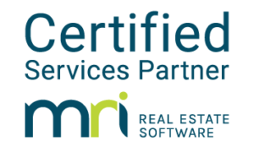









MRI Support & Services
Trusted solutions from the first globally certified MRI Services Partner
Consultants
17
10+
Analysts
Developers
Team members
Years of
MRI Experience
Testers
45+
Flexible billing and resourcing models
1st
MRI Clients
120+
Globally Certified MRI Software Partner
Full Time Equivalent
(FTE)
Time and Materials
(T&M)
Fixed
Cost
(FC)
MRI Projects

Slide 9
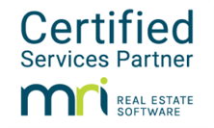








MRI Support & Services
Trusted solutions from the first globally certified MRI Services Partner
MRI Upgrades
MRI Support
Self-hosted or SaaS
Minor or major upgrades
Windows to Platform X migration
L1: First line support
L2: Investigation and troubleshooting
L3: Enhancements and customisation
MRI Reporting
MRI Consulting
MRI Report Design toolkit, Rapid Reports, Reporting Gateway
Modify standard reports or create entirely new ones
Powerful dashboards through MRI’s own toolkit or Power BI
Blueprinting and discovery
Process definition and documentation
Solution assessment and design
MRI Workflow Design
MRI Web Design
Standardise processes and coordinate teamwork
Automate task creation, assignment and notifications
Conditional workflow routing, performance analysis
Customise standard MRI pages or create new ones
Integrate into existing MRI processes
Can include custom data or integrations
MRI Module Implementation
MRI Integration
Planning & analysis
Development & testing
Go live, training & support
Using MRI Information Exchange (MIX)
Integrate with existing APIs or design new ones
Integrate to in-house systems, third-party or public domain

Slide 10



Collaboration
We can deliver projects end-to-end, or augment your internal team or existing partners
MRI Product Development
MRI Development Outsourcing
We have augmented MRI Software’s Product Development team with our resources to assist with:
Internationalisation of MRI Version X
Resolution of EMEA Corporate Management module rent up and billing issues
Delivering the Prospect Connect leasing portal
Other consulting firms frequently engage Open Box to assist with development on projects where they have conducted initial analysis and design.
MRI Software’s GPS team often subcontracts out customisation and implementation work to our team, for a wide variety of their clients.
MRI Integrations Consulting
Client Team Augmentation
Vendors like Nexus, AvidXchange and Corrigo have used Open Box as expert consultants to help design or modify their integrations to MRI.
Clients like AvalonBay Communities use Open Box Software as a flex resource to augment and scale their internal development team.
This allows them to undertake special projects like upgrades, automations and enhancements as needed, while maintaining a smaller core team.
MRI Certified Product Partners like Honest Buildings recognise Open Box’s experience with the MIX API suite and engage us to consult on their projects.
Notes:
We have picked up that this project will require collaboration between the SEGRO team as well as one or more vendors
We have years of experience in working under various roles from working alongside the core MRI team on their actual product through fully outsourced and finally as part of a client or vendor team

Slide 11
Our Implementation Approach
Following the MRI Framework and industry best practice
Project Management & Governance
Initiate
Blueprint
Build
Inspect
Launch
Project on-boarding
Define scope and responsibilities
Review project charter
Capture project success criteria
Document and approve success criteria
Functional requirements
Workflow requirements
Security requirements
Data & migration requirements
Gap analysis
Solution design
Planning & Timelines
Configure modules
Configure security
Configure workflows
Data cleansing, transformation and migration scripts
Enhancements
Reports
Internal validation & quality assurance
Project team and super-user training
Test planning & scripts
Test data & conditions
User Acceptance Testing
Unit, Integration, System, Security & Performance tests
Regression testing
Go / No Go
Cutover plan
Upgrade / install / deploy / configure
Apply security
Production data migration / take-on
User guides
End user training
Handover
Post Go Live Support
Multi-module implementations require a phased delivery approach
Project Initiation
Project Blueprinting
Phase initiation, blueprint, build, inspect, launch (cyclic)
Project Launch
Notes:
The phases will seem familiar as I am sure MRI as well as the other respondents will all use this model
Our difference is the experience and exposure of the tasks under each phase
For e.g. you have already identified the 6 “batches”, but we would be wanting to use the blueprinting phase as a way to consult on what should be batched together so as to reduce the impact on any regression testing at the end as we would actually suggest testing each batch as well as then regression testing the other batches

Slide 12
Case Studies

Slide 13



MRI Support & Services
Case 1: Re-implementation
Case 2: Windows to Web Conversion
91
Revert RM to base MRI, customise, upgrade
and migrate data
182
Self-hosted to SaaS migration, API integration and user training
hours effort
hours effort
1 month
FTE
3 months
T&M
duration
team model
duration
team model
Case 3: Consolidate and Upgrade
Case 4: Import and Configure
1,132
Consolidation of several customisations, upgrade and post-launch support
456
Configure GL, AP, RM & CM and import data for 33 entities
hours effort
hours effort
4 months
FTE
1 month
FC
duration
team model
duration
team model
Notes:
Pistilli RM
Originally approached for this project
Now have a monthly support FTE
JFK
Originally assisted with integrations into work order system
Now go to support team
UE
MRI originally implemented by RF and Redirect
Open Box then brought in for both project work and support and now internal MRI app specialist
Upgrade treated as opportunity to clean up etc.
Rose
Client wanted to move off custom application into MRI
Needed to work very closely to understand the drivers behind custom and then figure out ways to use core MRI to achieve vs. remove customizations

Slide 14









MRI Support & Services
Example projects
Case Study: AR Batch and Cash Apply Automation
Implementation, upgrade and customisation
The challenge
AP Bank Reconciliation Automation
Positive Pay
Reports
180+ properties
Time Consuming
Complicated
With tenant and non-tenant receivables managed in MRI
Cash receipts process manual, high effort and needed large team
Overpayments and complex contracts made matching hard
Windows to Web Conversion
Environment Consolidation and Upgrade
The solution
Chart of Accounts Streamlining
Portfolio
Migration
Export report provides charges in Wells Fargo format
Wells Fargo performs initial match
Wells Fargo csv file is imported into MRI
Unposted batch created with cash receipts applied
Prepayments created for balance of overpayment
JobCost Module Implementation
Budgeting & Forecasting Module Implementation
The result
Bulk of receipts handled automatically
Time saved and errors reduced
Staff have time to focus on quality assurance
Notes:
AP bank recon – automatically checking off cleared payments in bank rec so human did not have to
Positive Pay reports – this is a US example (check clearance) but relevant to cash and bank management

Slide 15




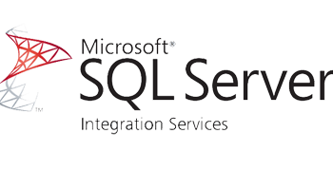
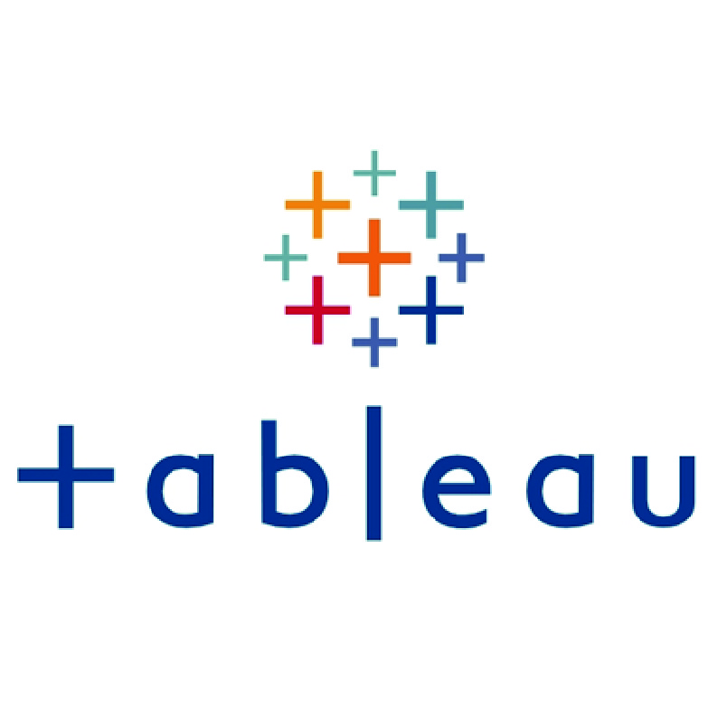



Global Reporting
Our range of expertise allows us to partner on all aspects of highly complex projects
Property and corporate budgeting systems enhanced and integrated
New data warehouse
New custom Reporting Tool to provide standardised global reports
Delivered in 9 months
Prop
Corp
Local GAAP to IFRS
Three separate MRI instances aligned and customised: forms, reports and databases
Local currency to USD
Executive reporting
USA
China
UK&EU
Combined with data from other applications in Tableau for dashboards and analytics
New custom Admin System to manage transformation and allocation rules
Global alignment of standards and processes
India
Brazil
Notes:
Very similar project to what you are attempting including the reporting
Multiple languages / jurisdictions
Needed “single version of truth”
Data stored differently but reporting off agreed COA etc.
Very time sensitive – Jan 1 had to be live
Big bang – I was in US for go-live
Open Box involved at every level
Business (mappings etc.)
IT – planning / tech etc.
QA – called in last minute to help with UAT

Slide 16



MRI EU Application Support Team
Long term partnership delivering upgrades, support and enhancements to MRI
8
2-3
Single instance of MRI Windows
Corporate, Fund and Property
Entities in UK, DE, FR, BE, LU, SP, IT
Years
Support FTEs
2009-2017
Local currency and FX rates
Local language tenant invoicing
Local VAT including non-VAT tenants
Local billing frequencies and charges
Local GAAP to IFRS
Access control
Custom reports
Entity setup
Integrations
Issue resolution
Enhancements
Upgrades
Configuration
Service charge reconciliation
Property, fund and corporate budgeting
Expense reporting
Purchase orders
Development project management
Lease administration
SEPA-compliant direct debit payment
Electronic vendor payment
SharePoint (paperless invoicing)
Salesforce (corporate outreach)
MRI to Dynamics AX Migration
1
Data review
3
Data export
2
Data clean-up
4
Archive
Notes:
Supported globally
Number for EU
Level 1 through to Level 4
Eventual migration off to MS Dynamics

Slide 17
How Can We Help?

